Slide 1
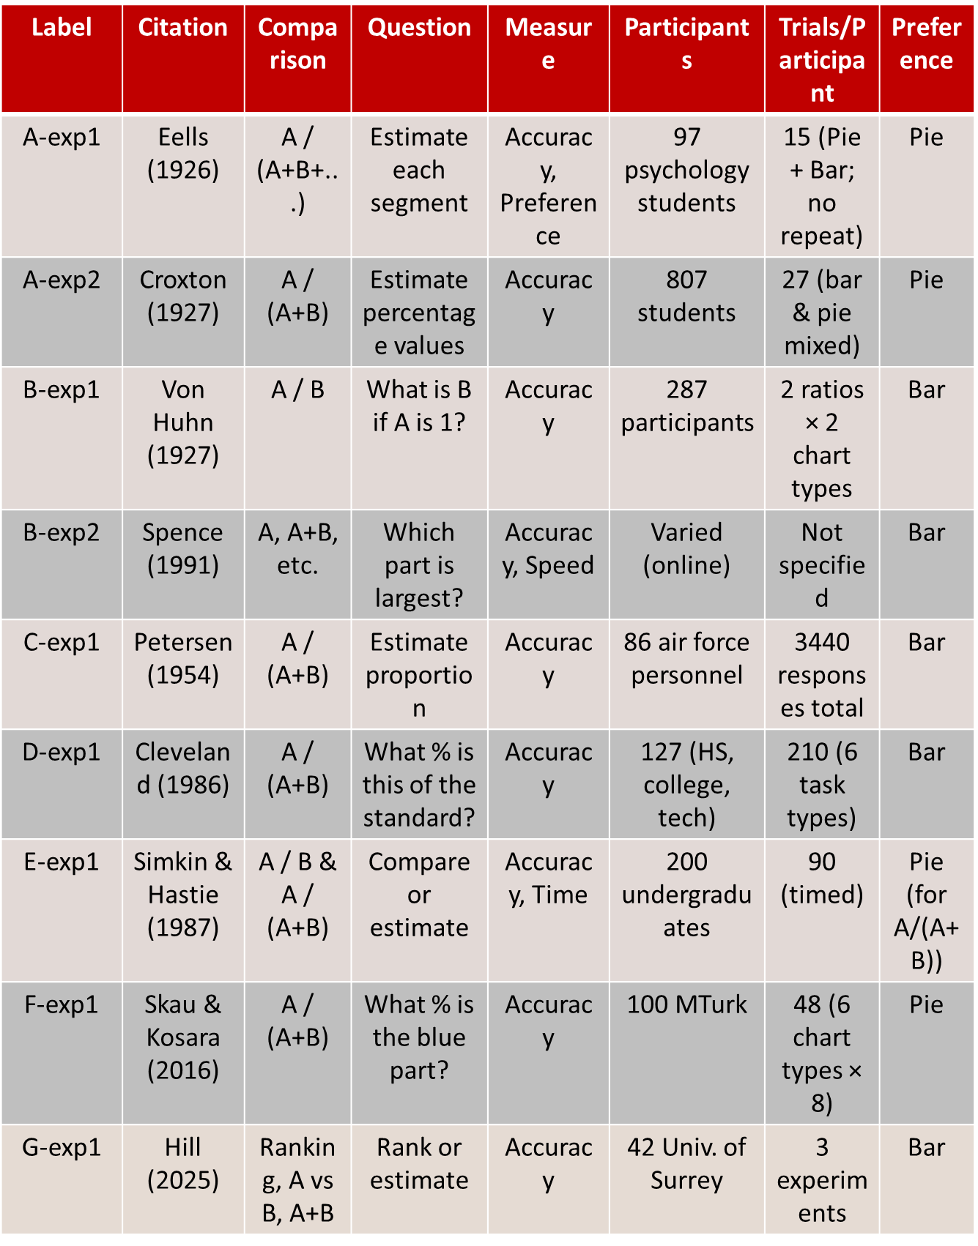
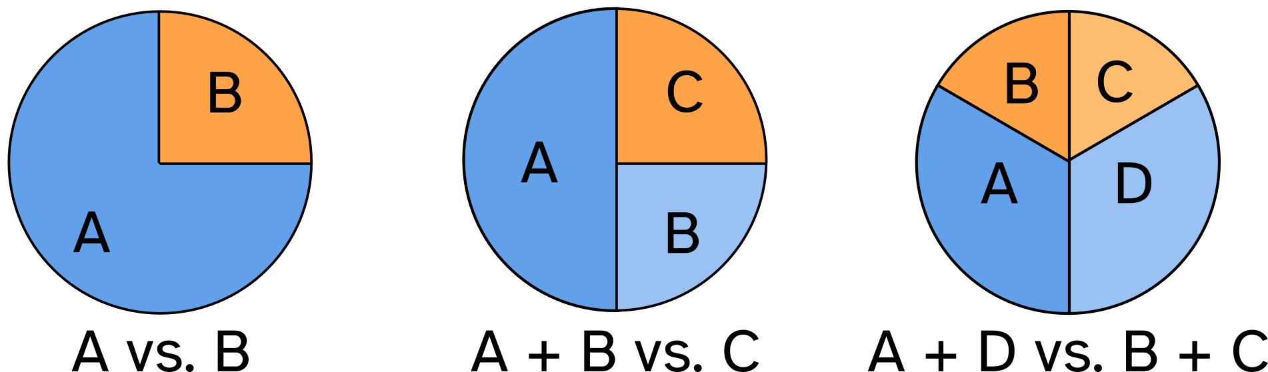
100 Years of Pies vs Bars
Maksuda Toma and Susan Vanderplas
Statistics Department, University of Nebraska Lincoln
Experimental Description
This project synthesizes almost a century of experimental research comparing pie charts and bar charts for part-whole data display Early research (Eells, 1926; Croxton, 1927; Von Huhn, 1927) focused on proportion estimation. Participants estimated chart section percentages. Both studies found that pie charts were more accurate, especially with equal-sized or many components. Comparison-based activities (Von Huhn, 1927) tested magnitude comparison skills by comparing A and B. Recent research has expanded visual tasks (Spence 1991; Simkin 1987). They compared bar, pie, and table charts in timed and untimed activities like A against B+C and A+B vs C+D. The graphical perception framework by Cleveland and MacGill (1984–1986) examined how visual encodings like position, length, angle, and area affect judgment accuracy. New online studies by Skau & Kosara (2016) and Hill (2025) examined perceptual biases and distortions. They showed that exploding or elliptical pies reduce accuracy, while standard pie charts are still successful in part-whole estimate tasks. Hill also examined ranking and size estimation, proving that no chart form works well for all tasks.
Summary of Experimental Studies on Chart Perception
Conclusion
As of now, no one has determined a definitive winner between pie charts and bar charts The effectiveness of charts depends on ratio, measurement, and perception aspects of the representation. In research, a chart should not be dismissed solely because it is deemed inadequate. Pie charts make it easier to assess proportions relative to the whole, but bar charts excel in comparing magnitudes and ranking activities. Performance fluctuates depending on whether the task entails value estimation, segment comparison, or identification of the major component. Generally, charts that delineate comparative parts (e.g., adjacent slices or bold outlines) enhance interpretability.
Future Research
Numerous constraints are present in both early and contemporary investigations Early research (1920s–1980s) lacked statistical rigor and used fragile measurement designs. Modern studies (Spence 1991; Hill 2025) improved methodology but still face challenges, especially with participant diversity. Broader participant diversity is needed across age, education, and cultural backgrounds. Future work should enhance sampling strategies and refine experimental approaches.
Result
The effectiveness of pie, bar charts depends heavily on the task type A vs B (Direct Comparison): Bar charts perform best in accuracy, speed, and user preference for comparing two values A / (A + B) (Part-to-Whole Estimation): Pie charts lead to more accurate judgments in part-to-whole tasks, especially with simple, adjacent segments. However, their advantage may decline when comparing non-adjacent slices in 3–4 component pies. A vs (B + C), A+B vs C+D (Grouped Comparison): Results are mixed. Bar charts are slightly better for A vs B+C, while pie charts outperform for grouped comparisons like A+B vs C+D Ranking Tasks: Bar charts enable faster and more accurate ranking of multiple parts due to clear alignment Magnitude Estimation: Pie charts tend to support better intuitive magnitude judgments, although slight estimation errors are more common
Reference
Croxton, F. E., & Stryker, R. E. (1927). Bar charts versus circle diagrams. Journal of the American Statistical Association, 22(160), 473–482. https://www.jstor.org/stable/2276829 Skau, D., & Kosara, R. (2016). Arcs, angles, or areas: Individual data encodings in pie and donut charts. Computer Graphics Forum, 35(3), 121–130. https://doi.org/10.1111/cgf.12888

